Slide 1
Breast Cancer
DETECTION
USING DEEP LEARNING AND MACHINE LEARNING

Slide 2
Team Members
1
2
Venkatakrishnan R
Varsha P
3
4
Keerthana Rampa
Arjun Kumar SC

Slide 3

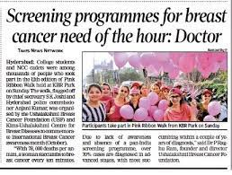
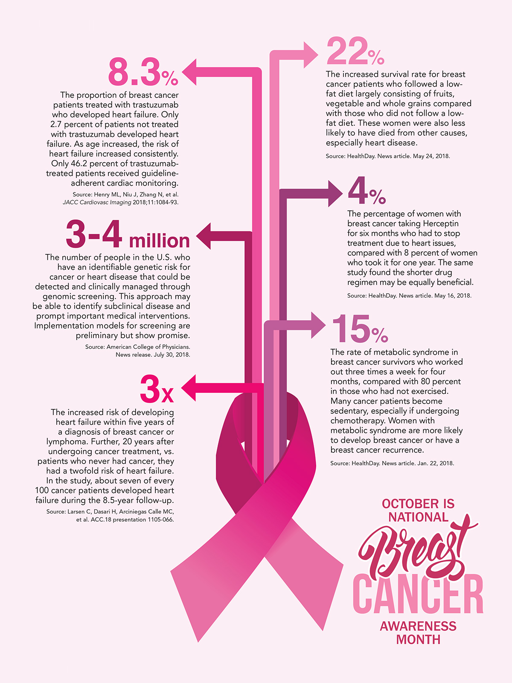
Problem Statement

Slide 4

Solution
Machine learning
Deep learning

Slide 5

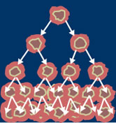
Dataset :
Breast Cancer Wisconsin (Diagnostic) Data Set
1) ID number
2) Diagnosis (M = malignant, B = benign)
Ten real-valued features are computed for each cell nucleus:
a) Radius (mean of distances from center to points on the perimeter)
b) Texture (standard deviation of gray-scale values)
c) Perimeter
d) Area
e) Smoothness (local variation in radius lengths)
f) Compactness (perimeter^2 / area - 1.0)
g) Concavity (severity of concave portions of the contour)
h) Concave points (number of concave portions of the contour)
i) Symmetry
j) Fractal dimension ("coastline approximation" - 1)

Slide 6
Data Preprocessing

Slide 7
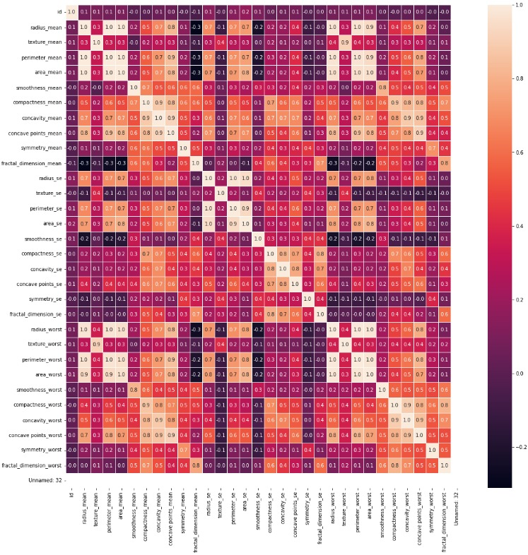
C O R R E L A T I O N P L O T

Slide 8
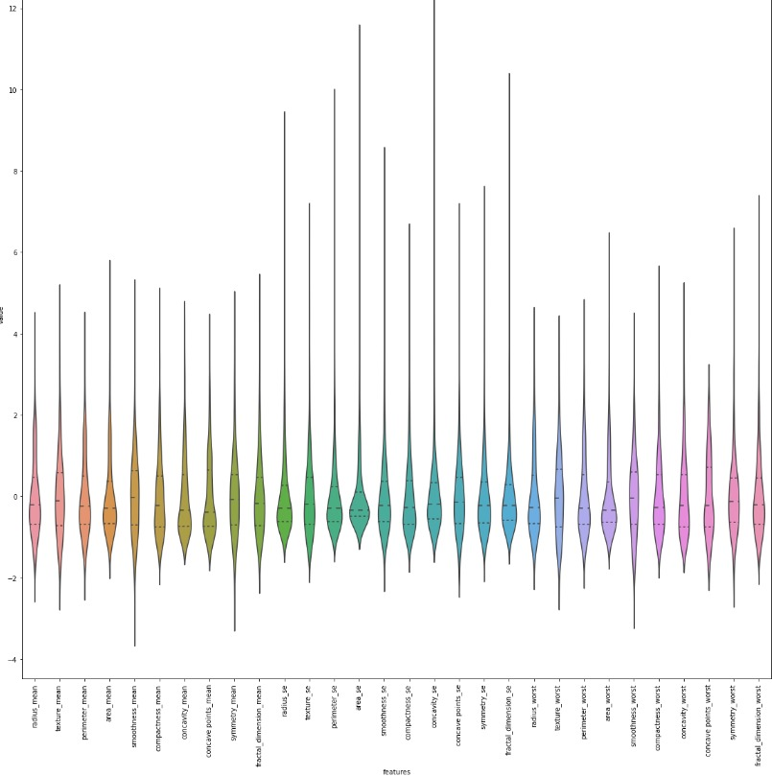
V I O L I N P L O T

Slide 9
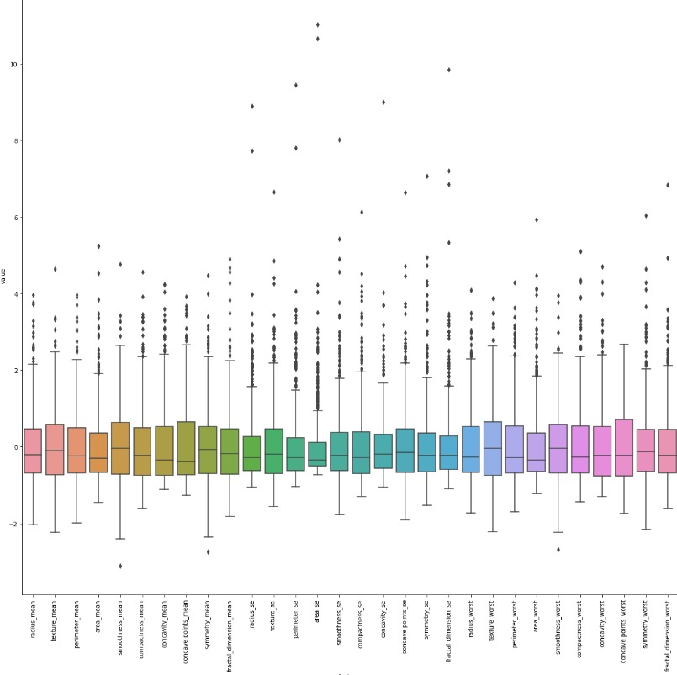
B O X P L O T

Slide 10
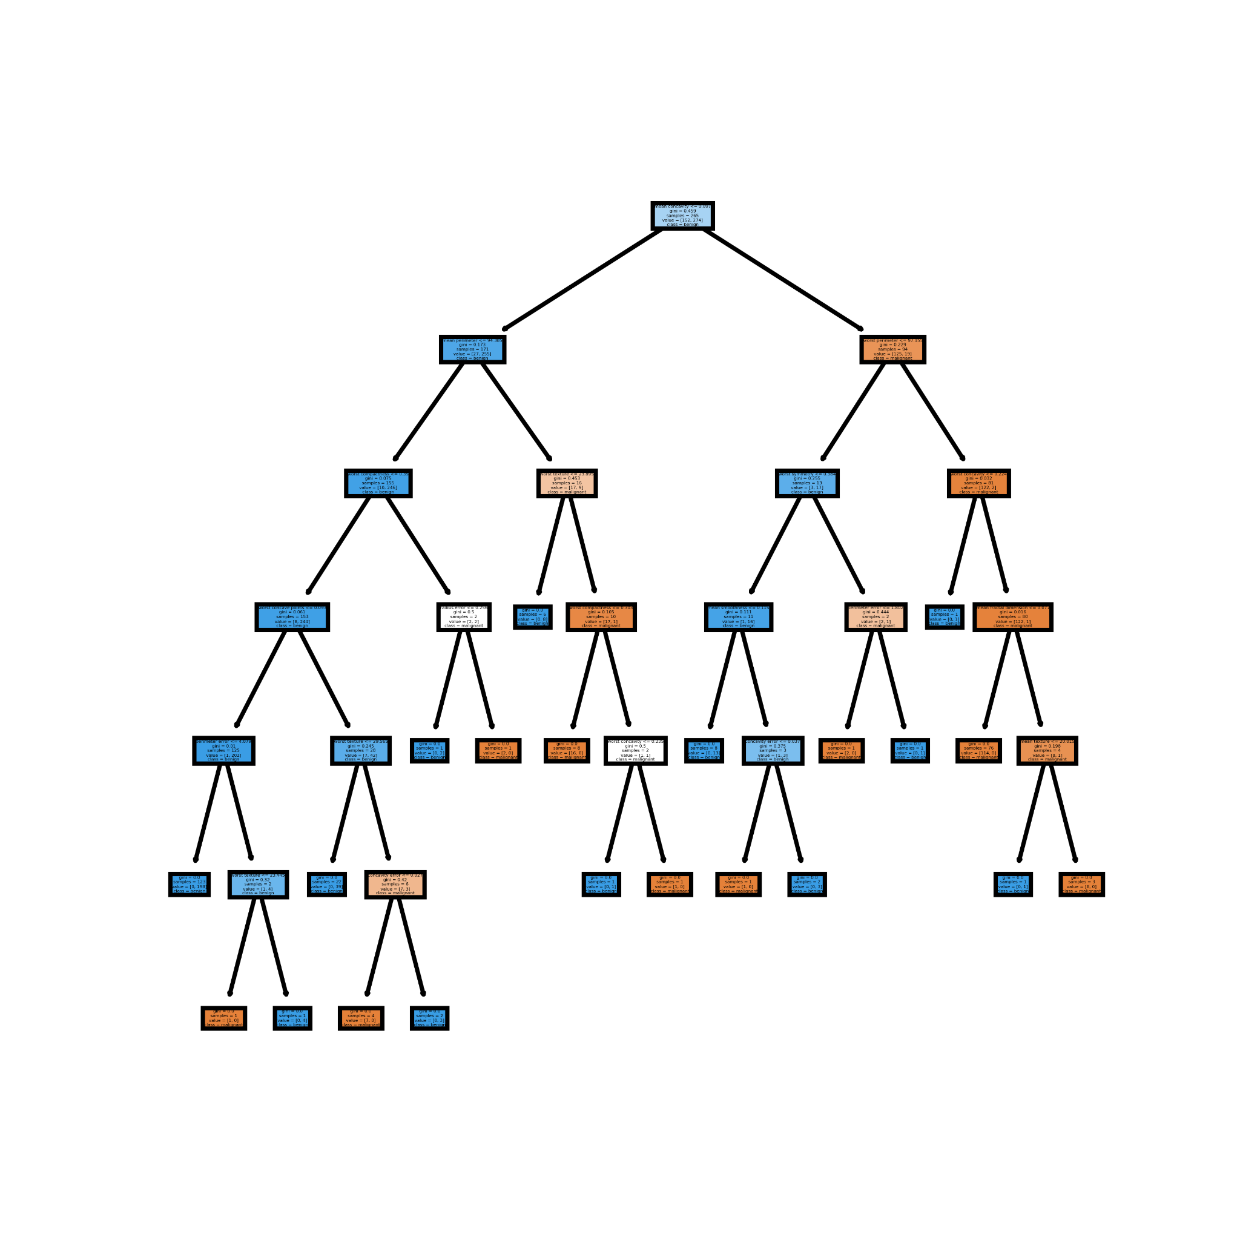
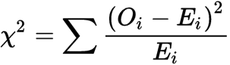
Machine learning
Chi-squared test
Random Forest Classifier

Slide 11
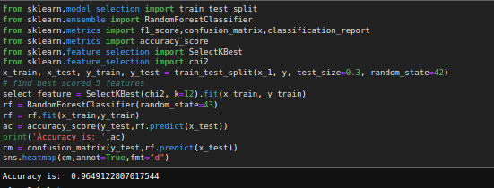
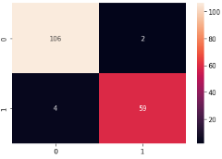
Machine learning

Slide 12
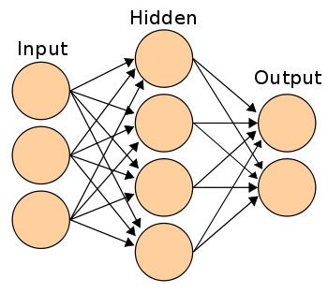
Deep learning
Chi-squared test
Artificial Neural Network

Slide 13
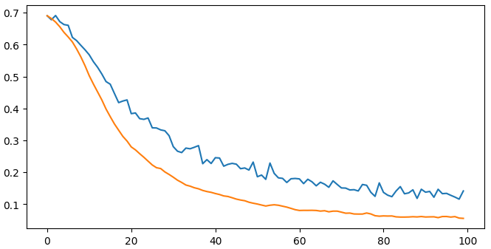
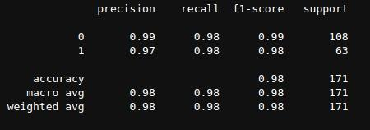
Deep learning

Slide 14



Thank you

